Slide 1
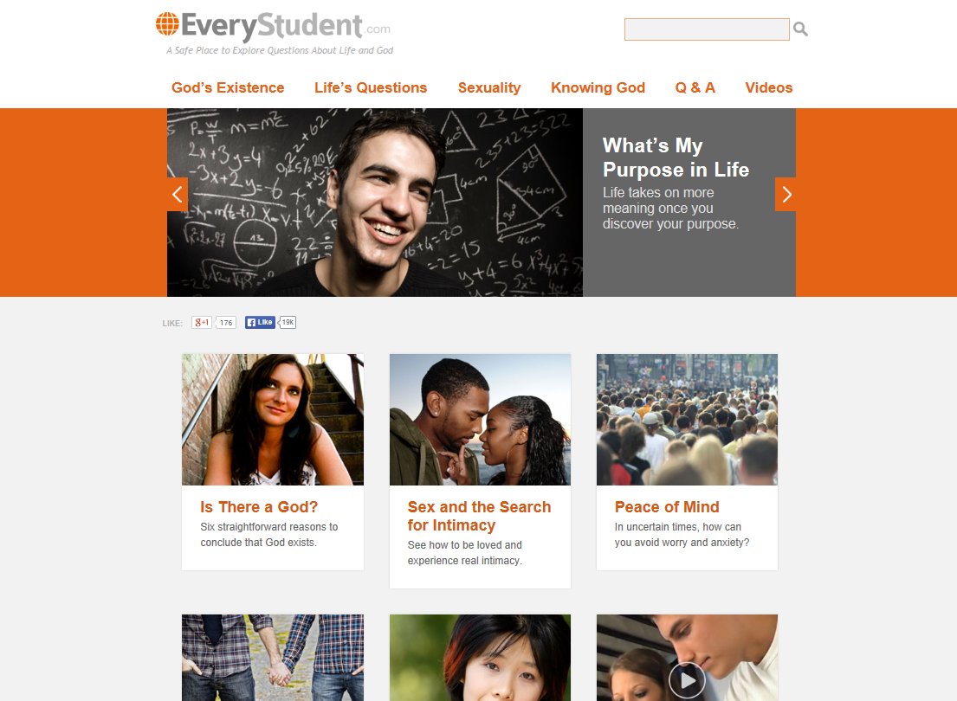

Slide 2
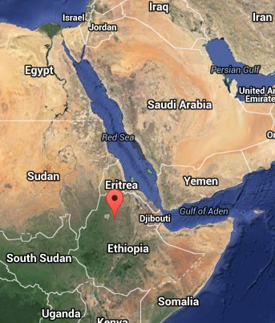
Yared

Slide 4


Slide 5
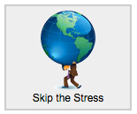
Thank you very much. God bless you forever! please do not stop teaching me. I now understand the concept of faith!

Slide 6
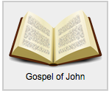
God bless you!!!!! I am very happy. thanks to God, for being with you on this very amazing study! I got a compass to see Jesus in the bible and wisdom for my journey! Each part is removing blindness from my life!!! Thank you!!!!!

Slide 7

My eyes are opened now through your lessons!!! I started to teach your lesson on whatsapp, to the new believer's. All glory belongs to God. Thank you 'go extra with jesus. ~yared

Slide 8
This website, EveryStudent.com, is my journey! it is satisfying their questions and doubts. It is strength for the believers faith -- and a way for non-believers to come to Jesus!

Slide 9
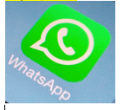
…this study and websites continue to bless many lives through me – I am reaching Muslims on whats app- I tell the truth more than 700 people have been blessed though this. And now new believers, around 33 -- their numbers are increasing daily.

Slide 10
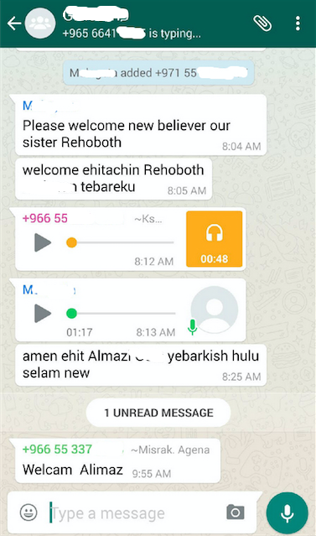
+966
Saudi Arabia, also Yemen, Sudan,
Egypt,
UAE, Libya, etc.

Slide 11
Yared

